Slide 1
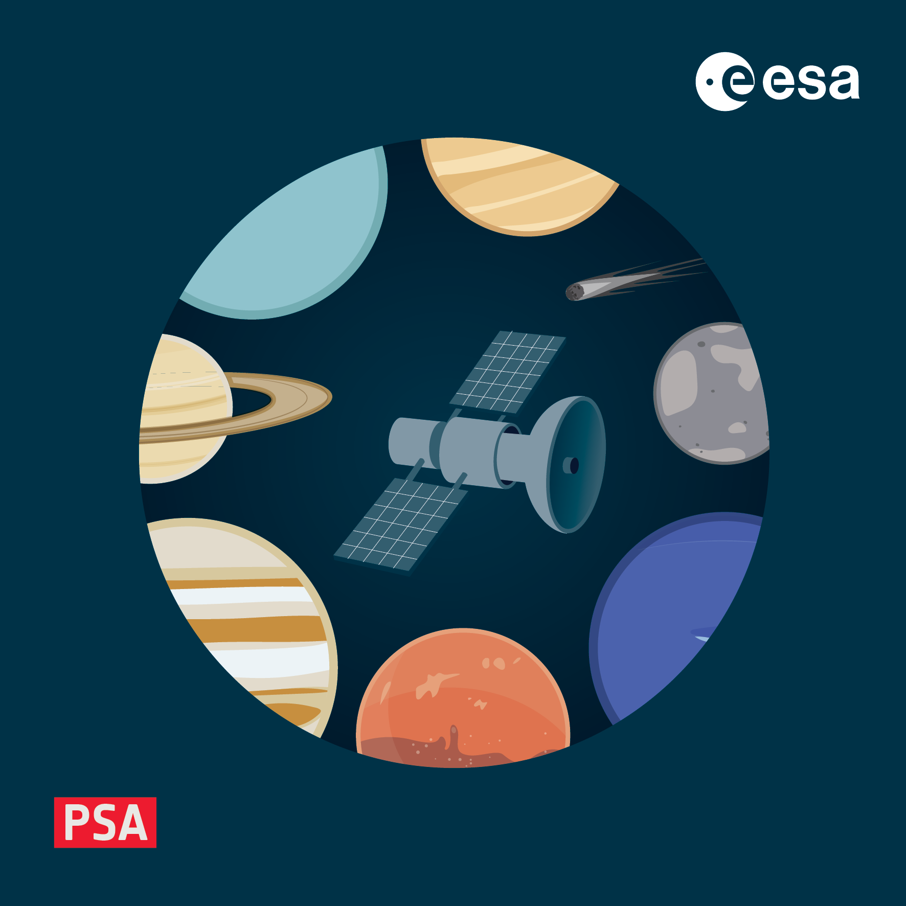
Discipline Dictionaries
4-8 November 2024, ESAC, Spain

Slide 2
Take home message
Make your data discoverable in the archive thanks to their metadata !
An archive search is not looking at the data content, but at the metadata.
PDS4 Common (core) dictionary to capture the basics.
PDS4 Discipline Dictionaries to capture the specifics.
When identifying the metadata of a PDS4 product, look into the existing Discipline Dictionaries
Interoperability of the archives and discoverability data products rely on common practices.
As much as possible, re-use pre-defined attributes.

Slide 3
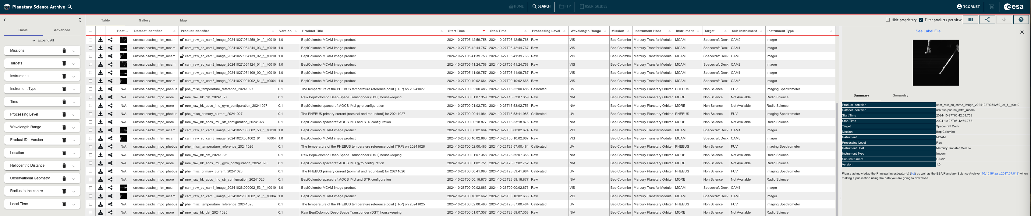
PDS4 Common Dictionary: Reminder
We use PDS4 common dictionary (core information model) by default, it allows to identify data products by:
Context: Investigation, Host, Instrument, Target
Other Observational attributes: Processing Level, Wavelength range, Time
Often this is insufficient to fully describe the data products.
Observation Area
(Investigation_Area, Observing_System)
Identification Area

Slide 4
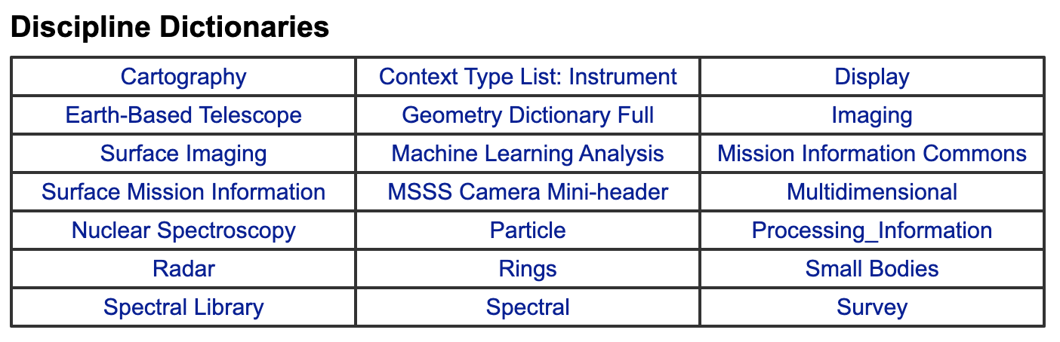
PDS4 Discipline Dictionaries
21 Discipline Dictionaries exist in the PDS !
Each Discipline Dictionary has a GitHub repository (https://github.com/pds-data-dictionaries).
Only few dictionaries have documentation outside the schema. Not always easy to use, but useful!
Raising an issue: https://github.com/pds-data-dictionaries/PDS4-LDD-Issue-Repo/issues/new/choose
Some of these dictionaries are very specific and recent, not yet used in the PSA.
Currently the PSA supports 3 active flight mission in PDS4 (ExoMars, BepiColombo, JUICE)
Will be discussed today

Slide 5
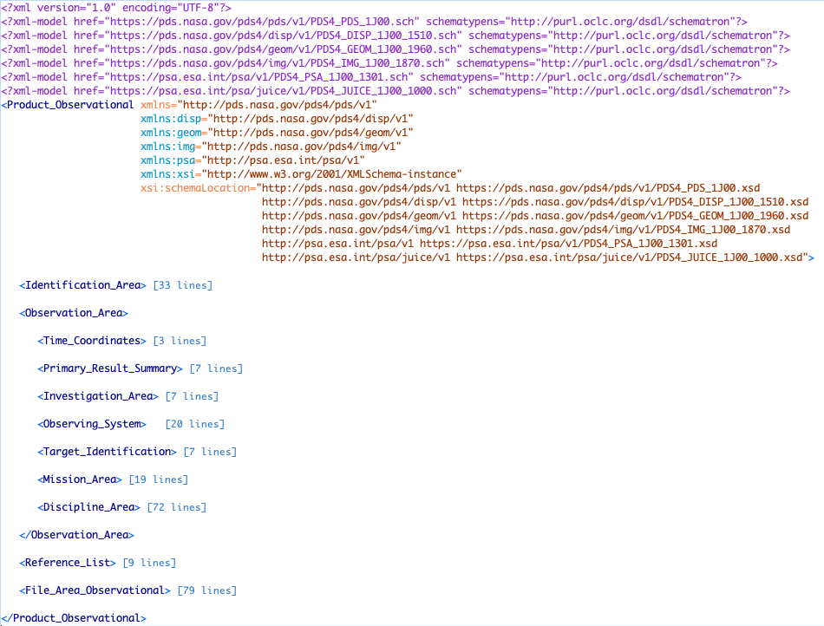
PDS4 Discipline Dictionaries
When using a discipline dictionary
Add it to the XML declaration of dictionaries
Schematron location
Dictionary namespace prefix
Schema location
Discipline dictionaries are used in the Discipline_Area of the Observation_Area (for an Observational_Product)
Local_Internal_Reference (Discipline_Area) and local_identifier (within the Data Structure) to associate objects and descriptions for most disciplines.
Has the Local_Internal_Reference referring to the local_identifier of the object
Has the local_identifier of the object

Slide 6
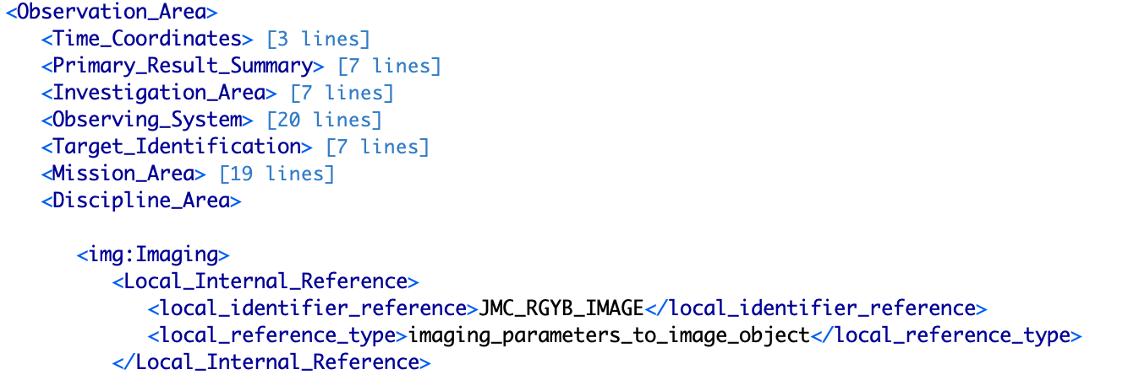
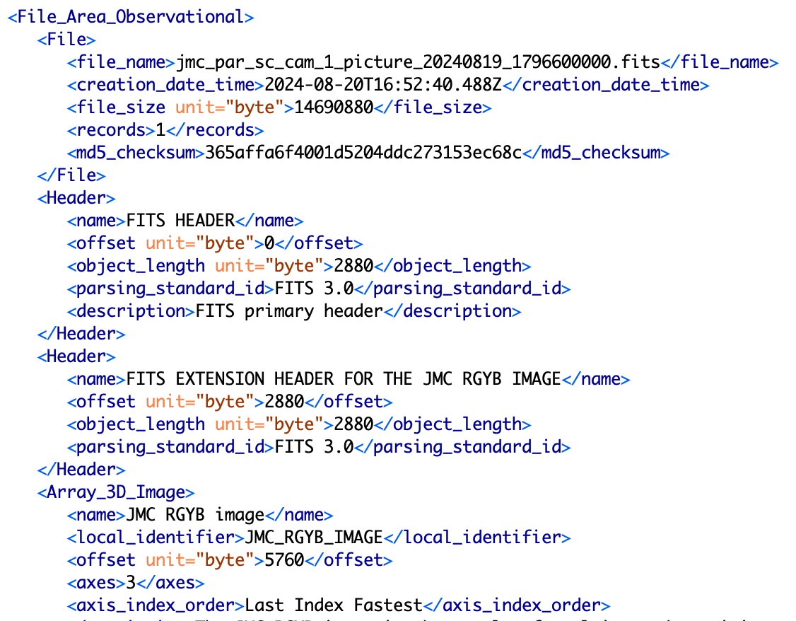
PDS4 Discipline Dictionaries
Has the Local_Internal_Reference referring to the local_identifier of the object
Has the local_identifier of the object

Slide 7
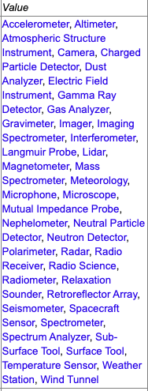
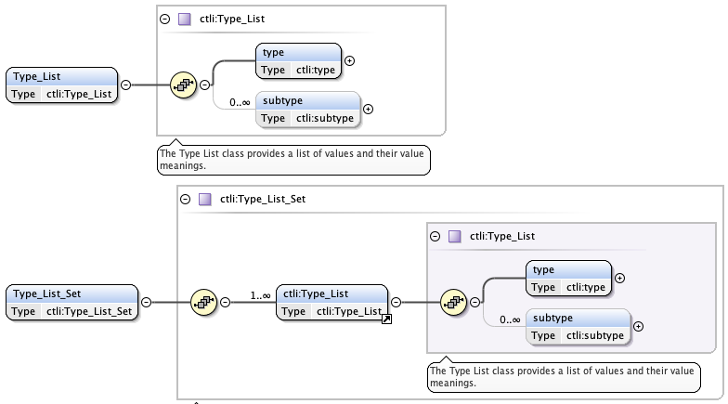
Context Type List Instrument dictionary (ctli)
Purpose: Used to capture the instrument type among a defined list of types for PDS4 context products.
GitHub: https://github.com/pds-data-dictionaries/ldd-ctli
Mandatory:
Type (only 1 per Type_List class)

Slide 8
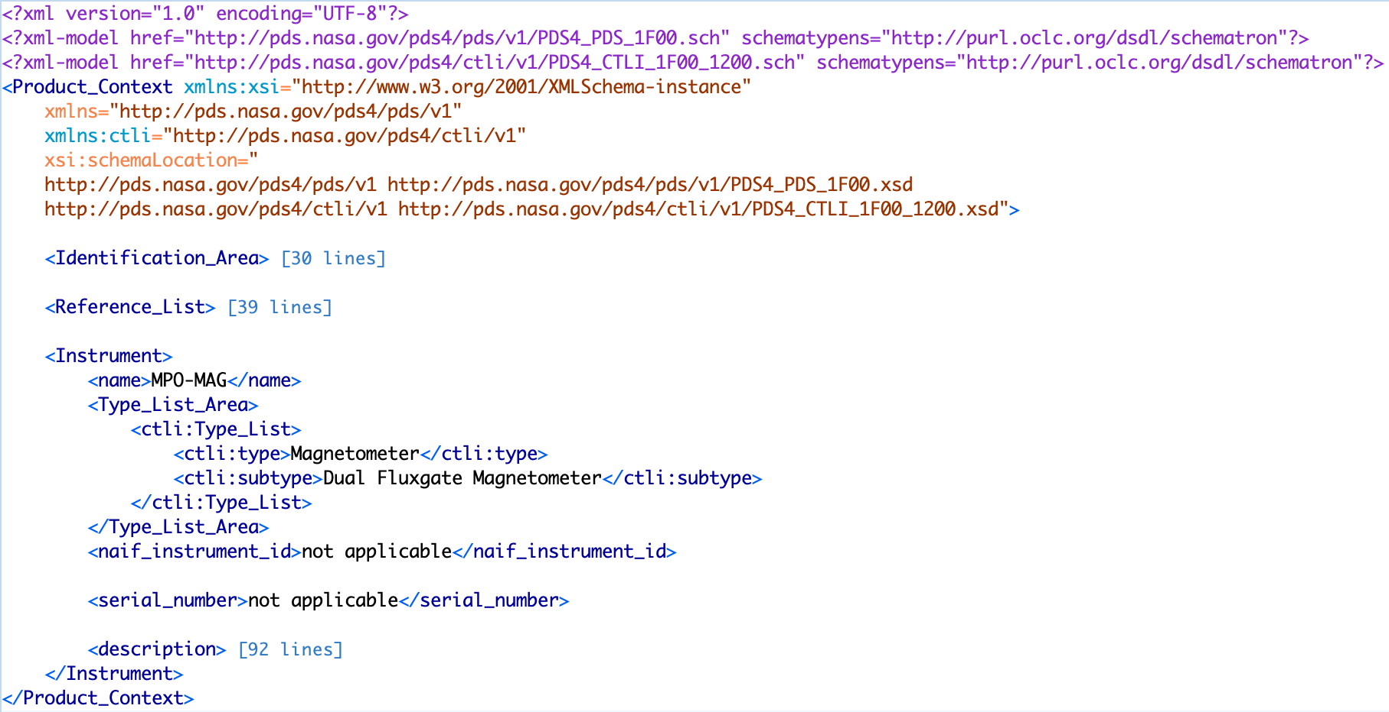
Context Type List Instrument dictionary (ctli)
Purpose: Used to capture the instrument type among a defined list of types for PDS4 context products.
GitHub: https://github.com/pds-data-dictionaries/ldd-ctli

Slide 9
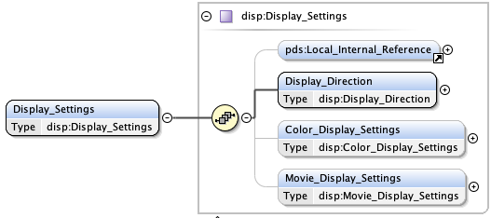
Display dictionary (disp)
Purpose: Used for imaging and spectrometer products to define how an array-type object with two or more dimensions should be displayed on, for example, computer monitor or video screen. This is a reasonably user-friendly dictionary!
GitHub: https://github.com/pds-data-dictionaries/ldd-disp
Mandatory:
(Local_Internal_Reference)
Display_Direction

Slide 10
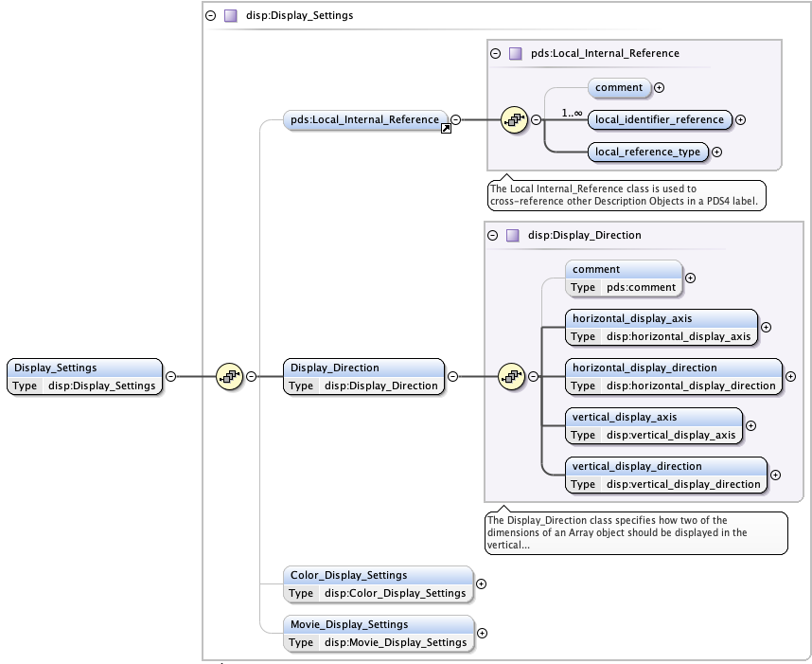
Display dictionary (disp)
The Local_Internal_Reference class creates the logical link between the data object and its Display_Settings subclasses
The Display_Direction is used to define the display orientation of an Array object.
Horizontal and vertical axes
Display directions along those axes

Slide 11
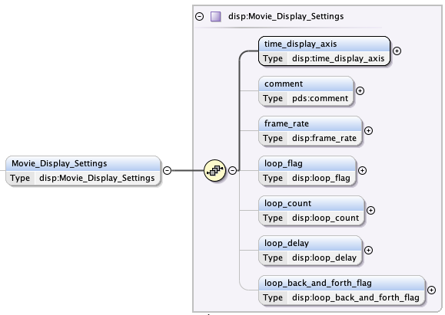
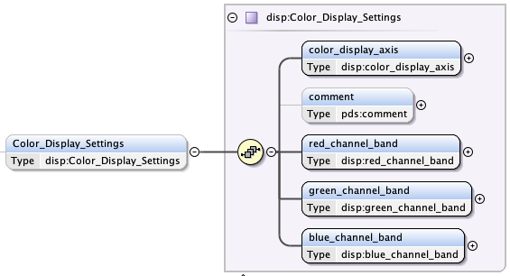
Display dictionary (disp)
The Color_Display_Settings allows to provide the RGB colour information of a multi-band array (works when reading the data with PDS4 tools).
The Movie_Display_Settings describes how an array can be displayed as a movie (e.g. band per band at a given rate).

Slide 12
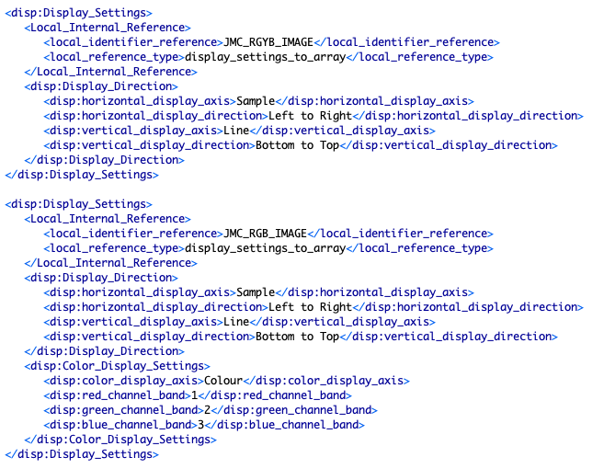
Display dictionary (disp)
Example giving the Display_Directions relevant to the first array in the PDS4 product using the Local_Internal_Reference.
Example giving the Display_Directions and Color_Display_Settings relevant to the second array in the same PDS4 product using the Local_Internal_Reference.

Slide 13
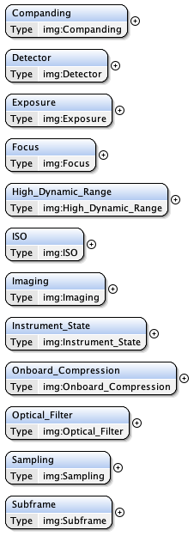
Imaging dictionary (img)
Purpose: Used for imaging and spectrometer products. The dictionary can be complex to use but has good capabilities to track metadata for imaging systems.
GitHub: https://github.com/pds-data-dictionaries/ldd-img
Bit-depth processing
Umbrella class to describe imaging product and instrument
State of the instrument detector
State of the instrument (e.g. temperature, voltage)
Exposure time
Data compression
Focus / autofocus of an obs.
Optical filter of a camera
HDR processing info
Sampling, scaling, companding, compression
Support for commercial cameras
Image subframe description

Slide 14
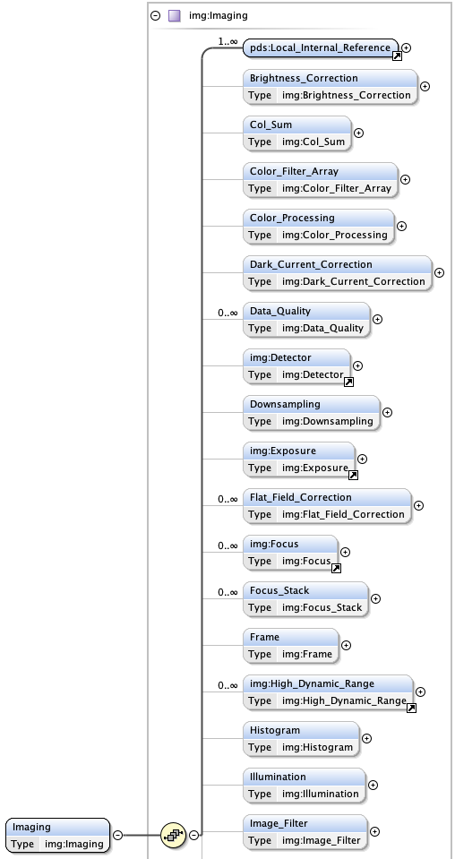
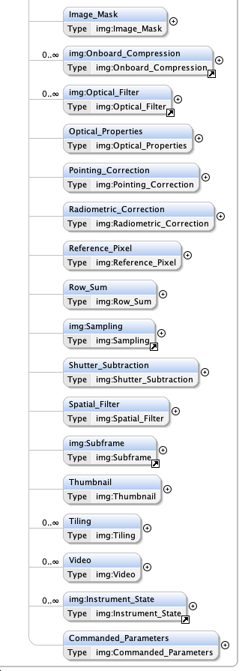
Imaging dictionary (img)
The img:Imaging class hosts 10 classes from the previous slide.
When using this class, the Local_Internal_Reference must be used to establish the relationship between the data object and its imaging properties.
Depending on the attribute and classes used, some will be mandatory to fill (see next slides).
Mandatory:
Local_Internal_Reference
But then…. Up to the class used !

Slide 15
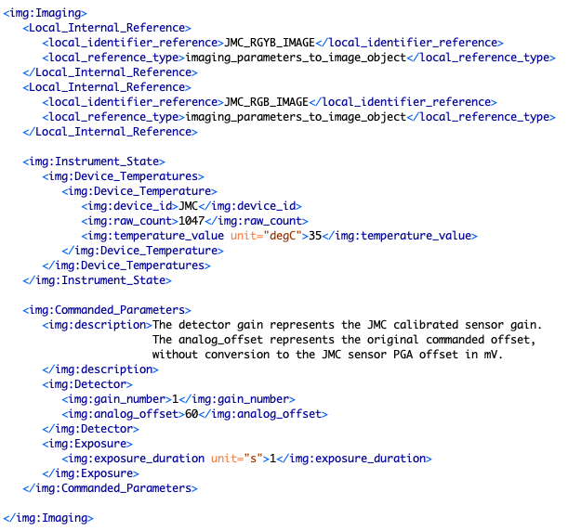
Imaging dictionary (img)
The Imaging class is used to logically relate the Commanded_Parameters and Instrument_State to the data object(s) via the Local_Internal_Reference
Detector and Exposure classes are used to capture the imaging settings within the Commanded_Parameters class, but could well be used outside the Imaging class.

Slide 16
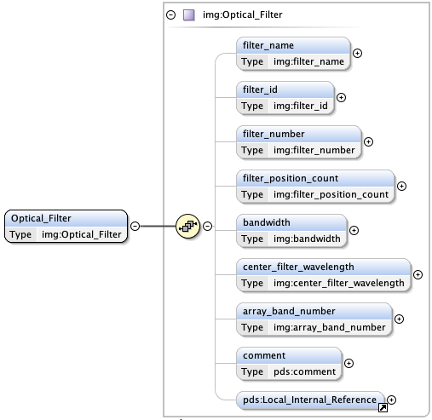
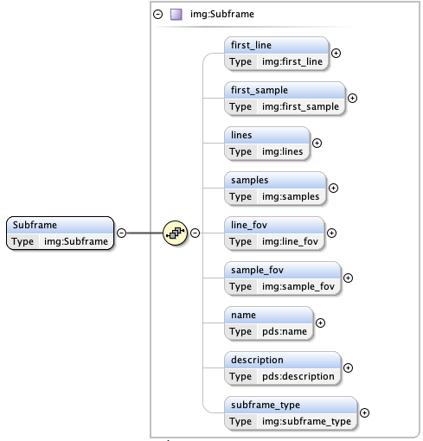
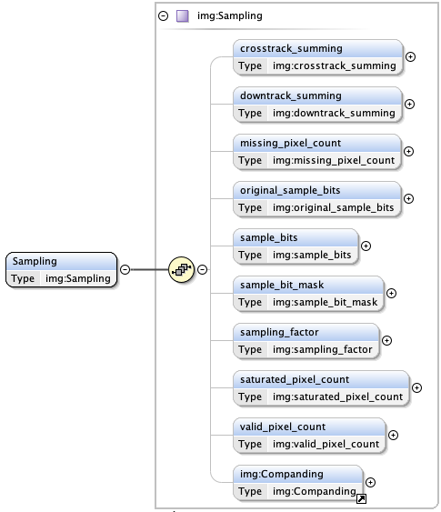
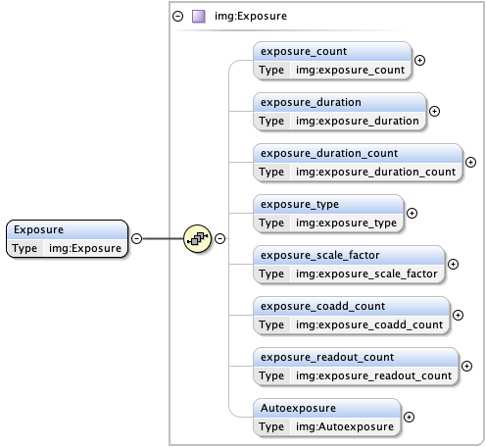
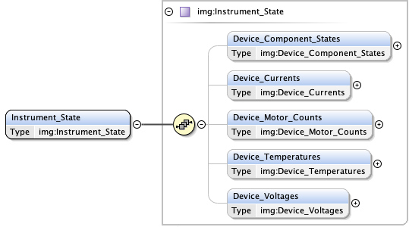
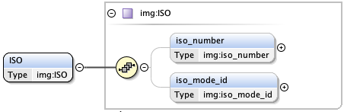
Imaging dictionary (img)

Slide 17
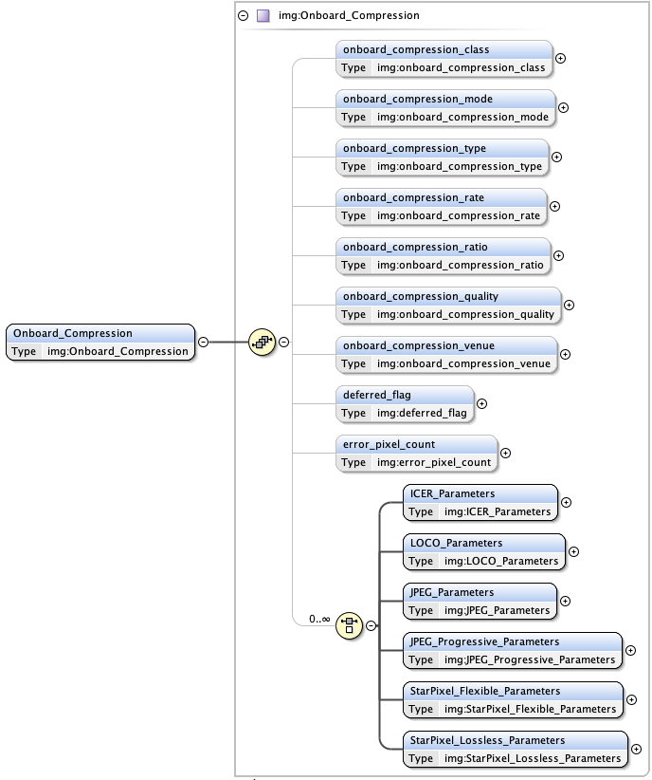
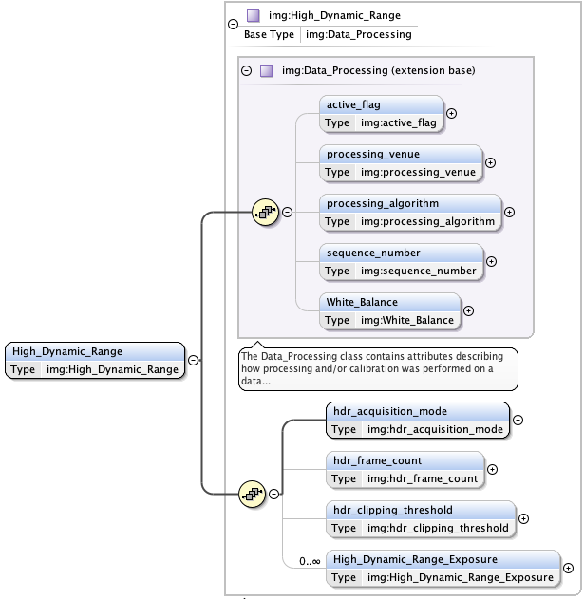
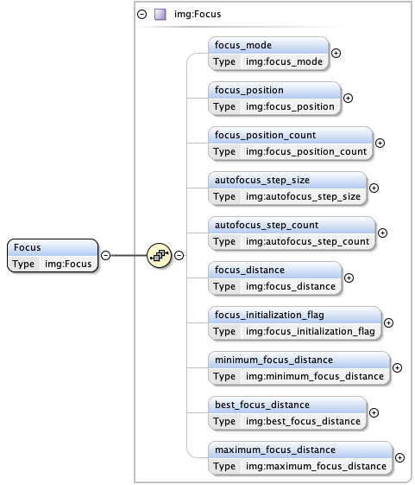
Imaging dictionary (img)

Slide 18
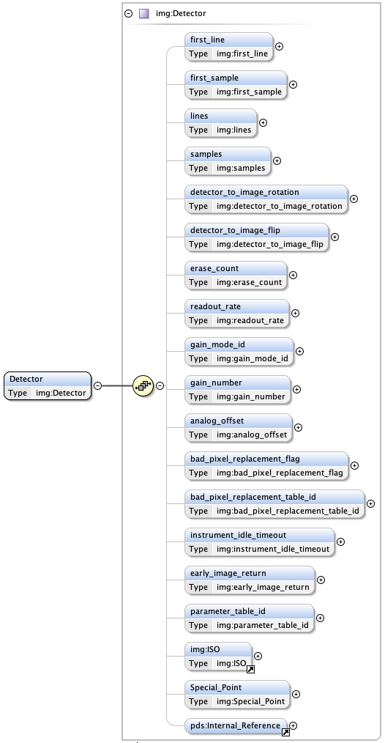
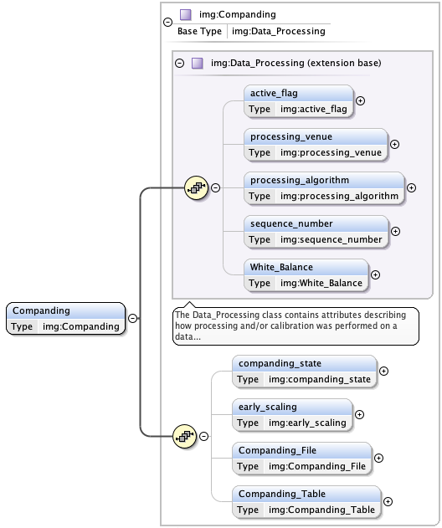
Imaging dictionary (img)

Slide 19
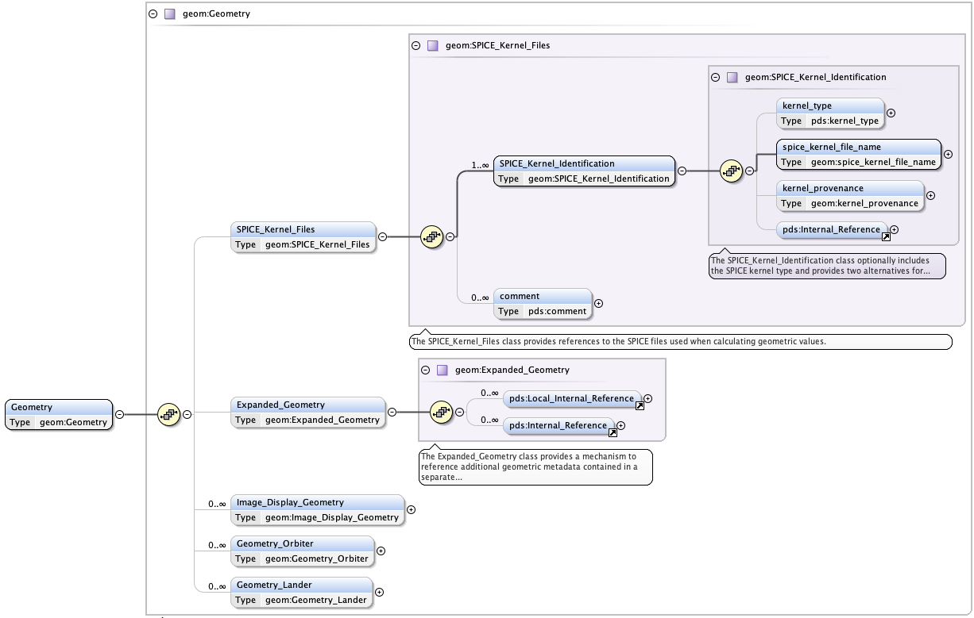
Geometry dictionary (geom)
Purpose: Provide geometry information relevant to the products for both Orbiter data and Lander data, as well as display definitions. The dictionary may be complex to use, but useful for performing searches based on geometry. Some support information: https://s2e2.cosmos.esa.int/confluence/display/PSAPUB1/7.+Geometry
GitHub: https://github.com/pds-data-dictionaries/ldd-geom
Mandatory:
SPICE_Kernel_Files is not formally mandatory, but required for traceability of SPICE computation.
Then… up to the class used !
geom:Expanded_Geometry used for linking the geometry with:
A data object in the same product (Local_Internal_Reference)
A data product providing the geometry as separate product (Internal_Reference)

Slide 20
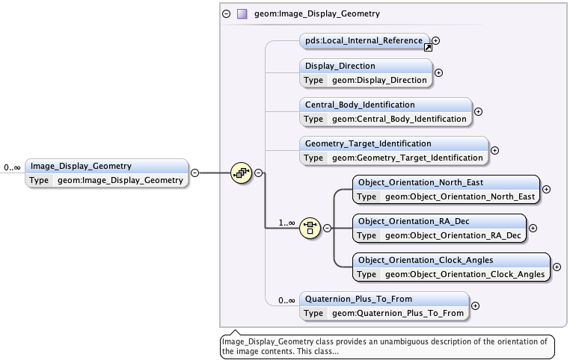
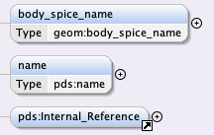
Geometry dictionary (geom)
geom:Image_Display_Geometry
Used to describe the orientation of the image content as displayed in the disp:Display_Direction class.
Target and
central body definition
In-orbit mission where the full FoV is on the surface
Flyby/tour mission where the full FoV is not on the surface

Slide 21
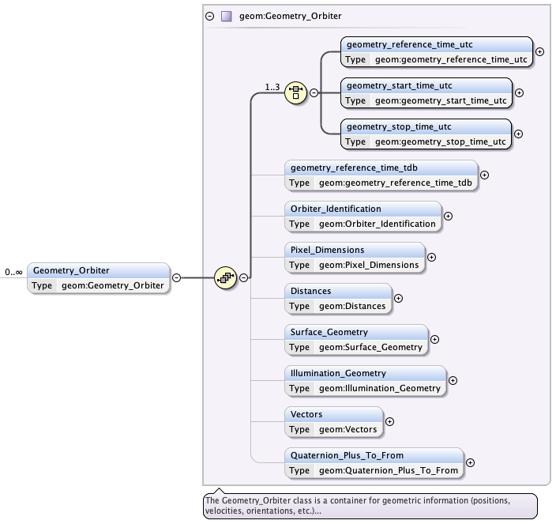
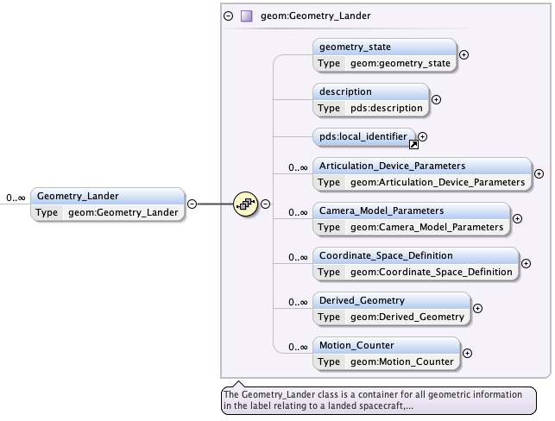
Geometry dictionary (geom)
Two main classes for providing the geometry, equally complex…
The Geometry_Lander is used for landed missions, the Geometry_Orbiter is used for flight missions.

Slide 22
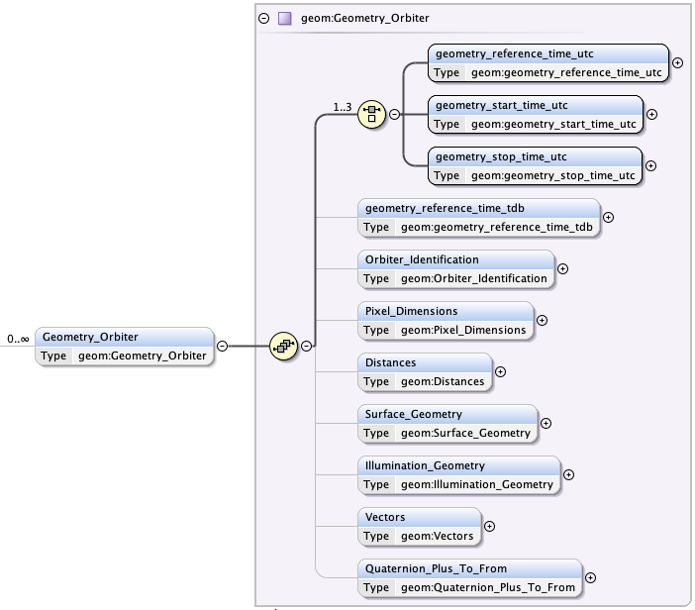
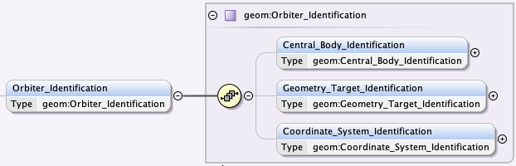
Geometry dictionary (geom)
geom:Geometry_Orbiter
Used to provide the geometry of an observation relative to a target seen from an orbiter. The class can be repeated.
At a specific time or within a time interval
The Orbiter_Identification is where the central body, the target and coordinate system are defined

Slide 23
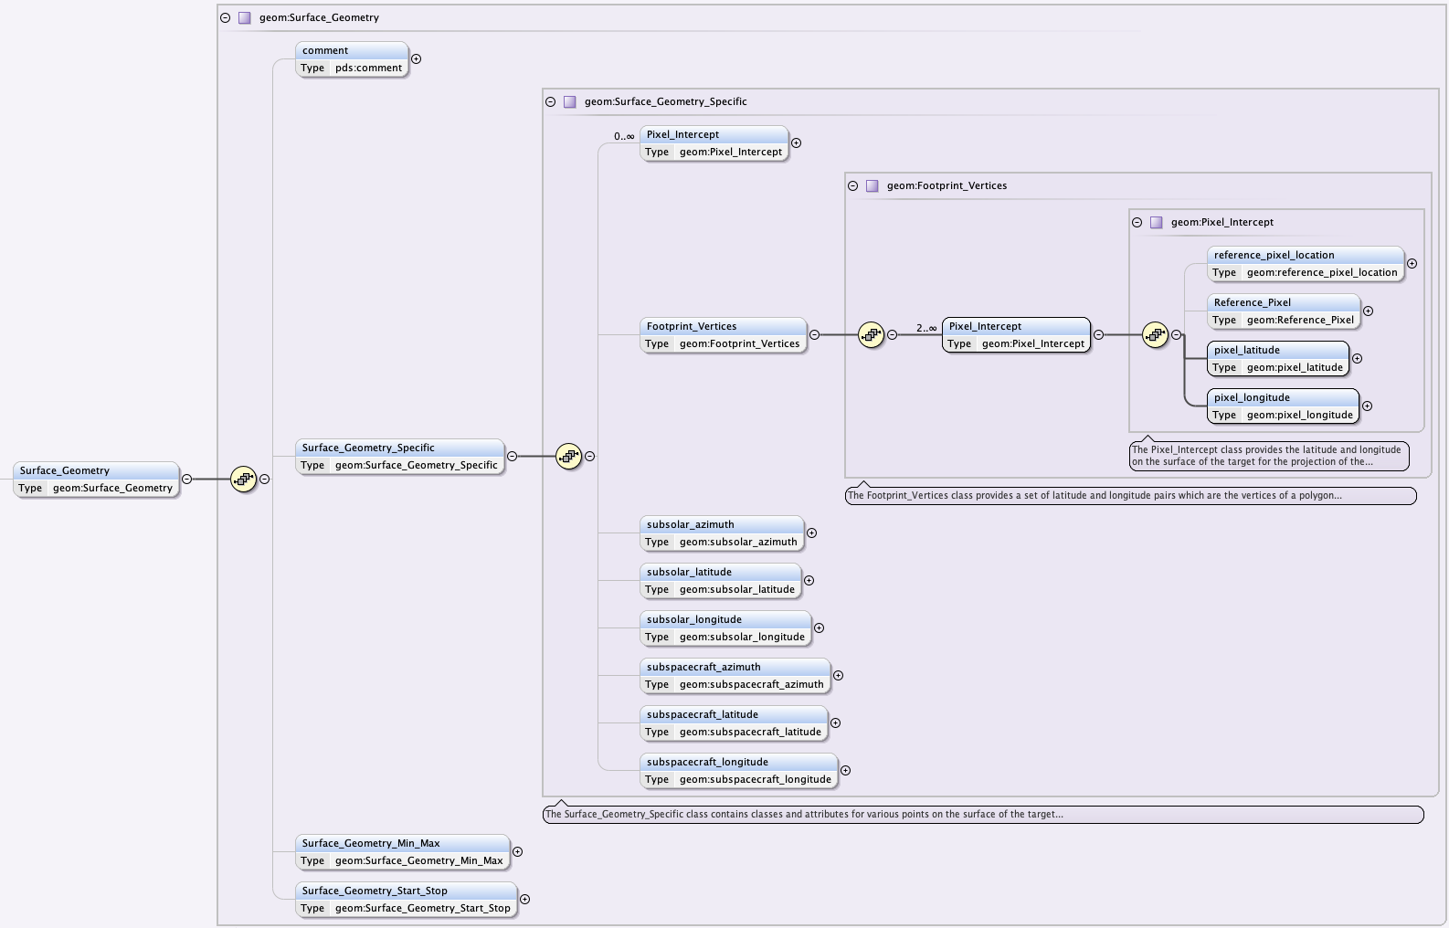
Geometry dictionary (geom)
geom:Surface_Geometry
Used to provide the geometry at intercept points at the surface of a target in many ways:
Min/max values in the observation
Values at start/stop of the observation
Predefined quantities
Footprint_Vertices is used for FoV intercepts
Subsolar and subspacecraft are also tracked.
Predefined quantities

Slide 24
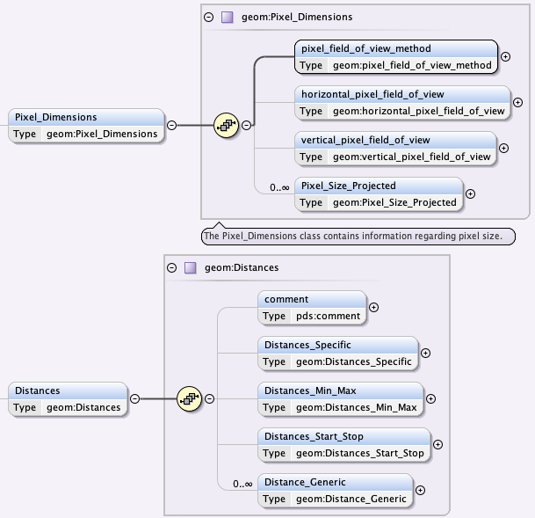
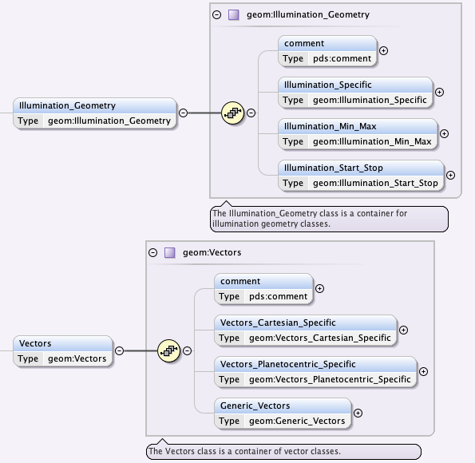
Geometry dictionary (geom)
geom:Geometry_Orbiter
Pixel_Dimensions, Distances, Illumination_Geometry, Vectors can be provided in multiple flavours.
Viewing conditions
Pixel size
Position, velocity
Distances

Slide 25
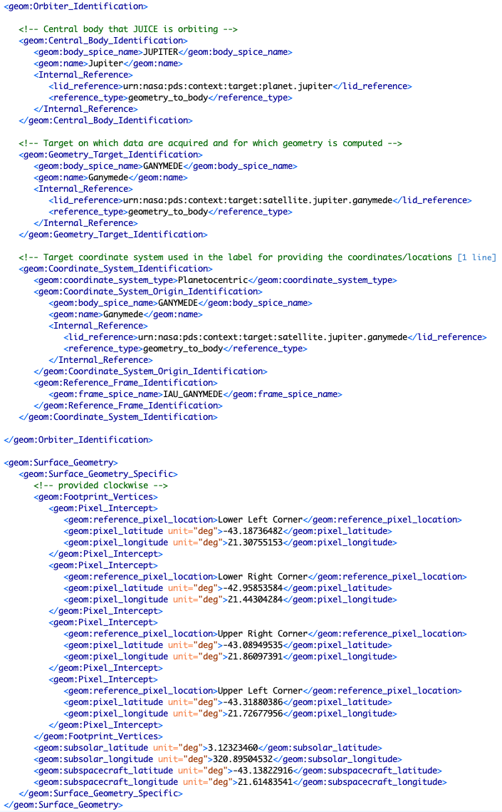
Geometry dictionary (geom)
Example of target definition for an observation looking at surface of Ganymede (target), orbiting Jupiter (central body)
FoV footprint location using the 4 corners of an image
(Additional surface geometry provided for sub-solar and sub-spacecraft locations)

Slide 26
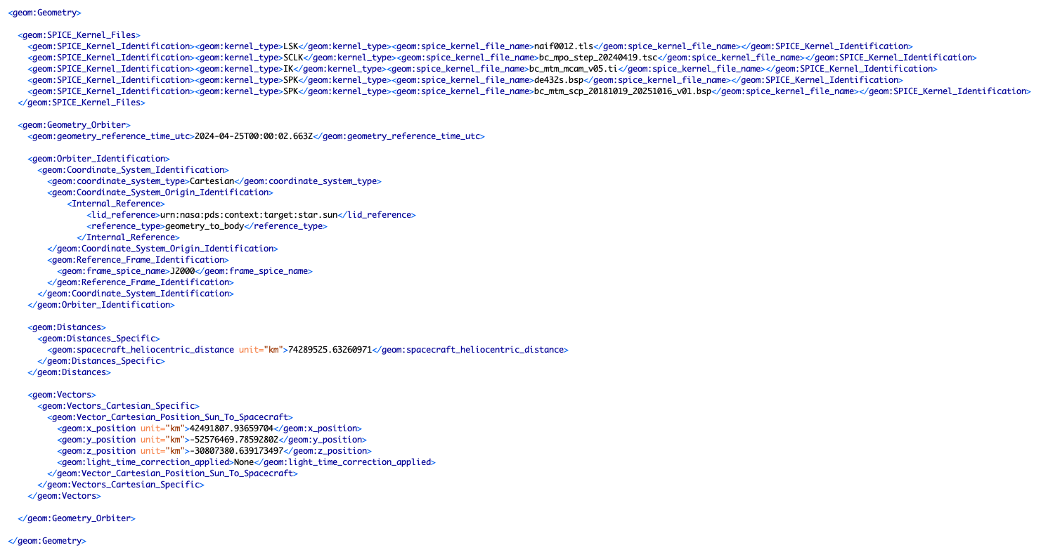
Geometry dictionary (geom)
Example of BepiColombo/MCAM data product providing the position of the spacecraft relative to the Sun in J2000.
Actual position in this coordinate system computed using the SPICE kernels listed above

Slide 27
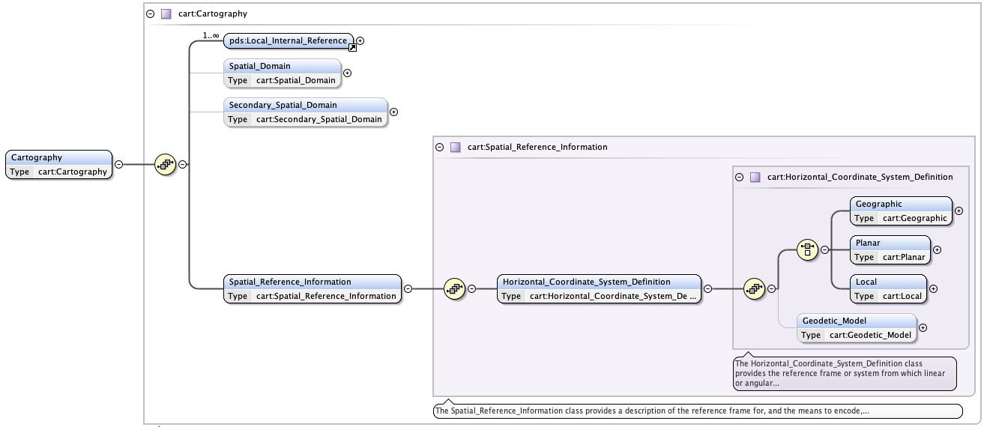
Cartography dictionary (cart)
Purpose: Describe map projections, including orbital, lander, and rings related definitions and descriptions. This should be used for any map projected PDS4 product (array/image based or GIS vector/tabular based).
GitHub: https://github.com/pds-data-dictionaries/ldd-cart
Documentation: https://pds-data-dictionaries.github.io/ldd-cart/index.html
Mandatory:
Local_Internal_Reference
Spatial_Reference_Information
Up to the selected system

Slide 28
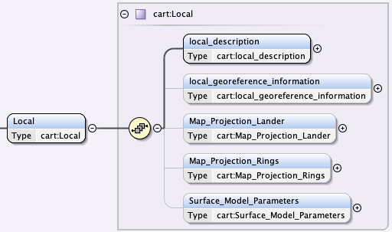
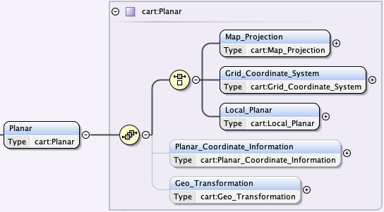
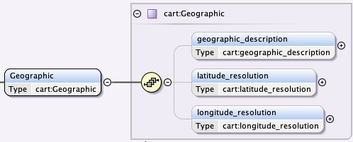
Cartography dictionary (cart)
Types of Horizontal_Coordinate_System_Definition
Geographic: latitude and longitude on a target surface
Planar: target surface projected to a reference plane
Local: coordinate system that is not aligned with the surface of the target.

Slide 29
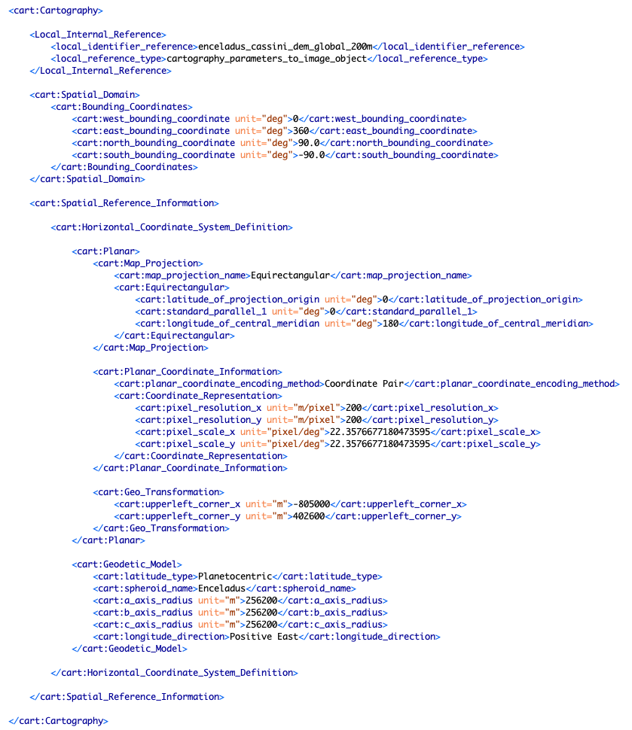
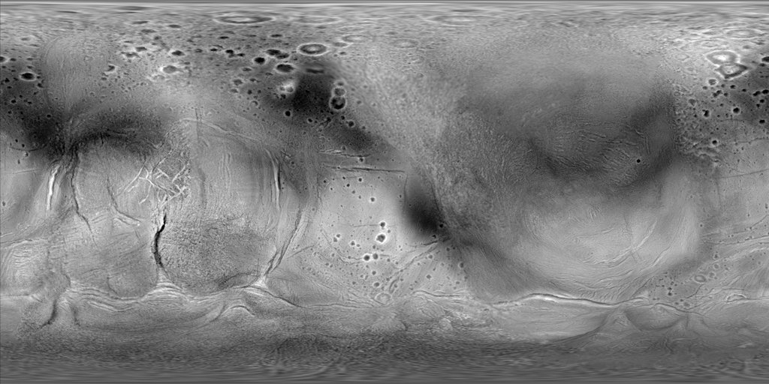
Cartography dictionary (cart)
Spatial_Domain
Is a bounding box defining the extent of the map.
Horizontal_Coordinate_System_Definition
Defines the map projection among the Geographic, Planar or Local options
https://astrogeology.usgs.gov/search/map/enceladus-cassini-global-dem-200m-schenk

Slide 30
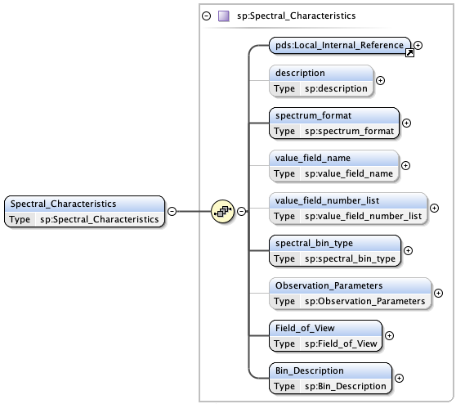
Spectral dictionary (sp)
Purpose: Define the Spectral_Characteristics of spectra (frequency, wavelength, wavenumber, energy)
GitHub: https://github.com/pds-data-dictionaries/ldd-spectral
Documentation: https://github.com/pds-data-dictionaries/ldd-spectral/blob/main/docs/spectralspectrosopynamespace.pdf
To link the data object to the spectral description
To define the format of the spectral data (1D, 2D, 3D, …)
Mandatory:
Local_Internal_Reference
spectrum_format
spectral_bin_type
Field_of_View
Bin_Description
To define the type of bins (e.g. wavelength, energy, ...)
The bulk of the work is here
(Observation_Parameters is optional)

Slide 31
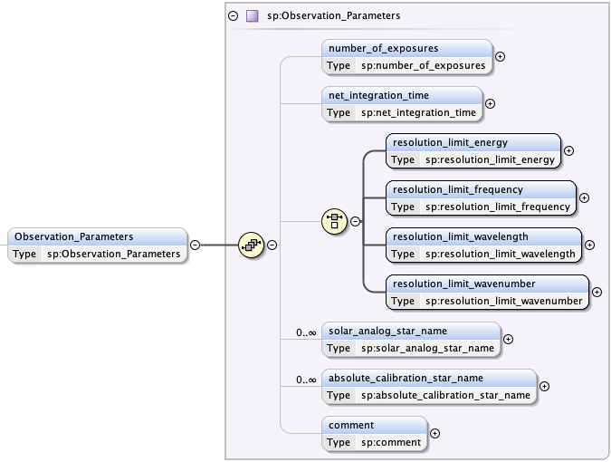
Spectral dictionary (sp)
Observation_Parameters: Optional, used to capture exposure time, spectral resolution limits.

Slide 32
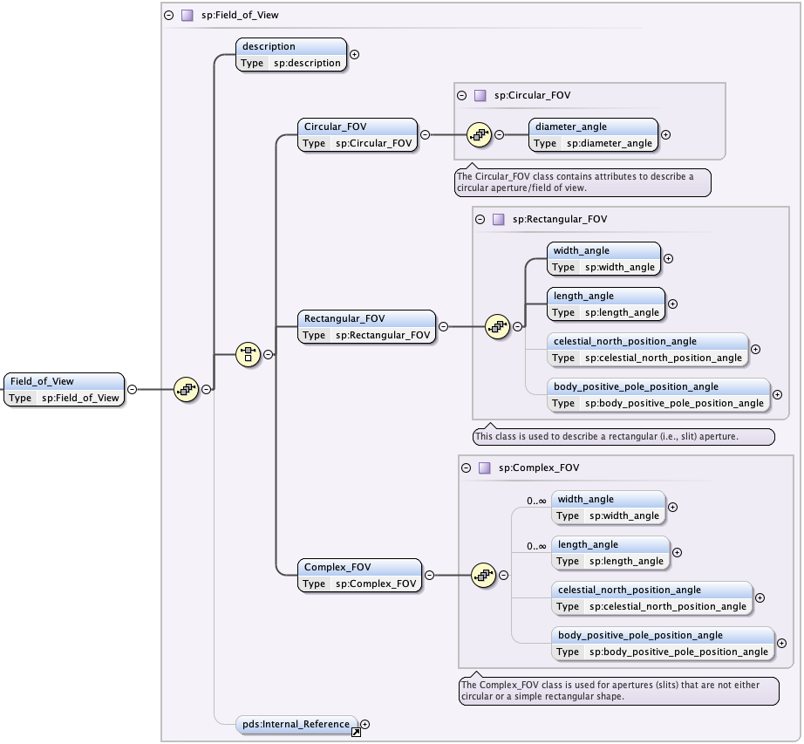
Spectral dictionary (sp)
Field_of_View: Mandatory, used to describe the field of view of the spectral data object.
Mandatory:
Description
One type of FoV (has mandatory attributes per type)

Slide 33

Spectral dictionary (sp)
Bin_Description: Mandatory, used to provide the spectral bins or link to lookup tables/arrays. This is the core of the information to be captured.
Examples: https://github.com/pds-data-dictionaries/ldd-spectral/tree/main/examples
Mandatory:
bin_profile_description
One type of spectral data definition (uniform, axis, lookup)
Uniformly sampled spectral data
Provides the spectral bins of a spectra per row in a flat table
Spectral lookup field in a table, or array (= spectral map)

Slide 34

Spectral Library dictionary (speclib)
Purpose: Capturing information from Laboratory Spectral Measurements. This dictionary includes the definition of samples (specimen) and types of measurements.
GitHub repo: https://github.com/pds-data-dictionaries/ldd-speclib
Documentation: https://github.com/pds-data-dictionaries/ldd-speclib/blob/main/Spectral_Library_Dictionary_Guide.pdf
Mandatory:
Specimen_Parameters
Specimen_Classification
measurement_segments
Measurement_Parameters
Sample
(specimen)
Measurement

Slide 35


Spectral Library dictionary (speclib)
Definition of the sample (specimen):
Name, id, location, properties, classification, …
Mandatory
Parameters
specimen_id
specimen_collection_location
specimen_owner_location
specimen_owner_name
Classification
specimen_type
material_origin
material_state

Slide 36


Spectral Library dictionary (speclib)
Definition of the measurement parameters
Capturing conditions, instrument setup, notes, techniques, …
Measurement types allowed
Mandatory
segment_number
Measurement_Instrument
measurement_type
spectral_range_parameter_name
spectral_range_min
spectral_range_max
spectral_range_unit_name
data_producer_name
nata_provider_name
[…]

Slide 37

Spectral Library dictionary (speclib)
Sample identification
Sample classification
Measurement description
https://pds-geosciences.wustl.edu/spectrallibrary/default.htm

Slide 38
Useful resources
Search the Discipline Dictionaries
Cartography: https://pds.nasa.gov/datastandards/documents/dd/all/current/#ch06s03.html
Context Type List Instrument: https://pds.nasa.gov/datastandards/documents/dd/all/current/#ch16.html
Display: https://pds.nasa.gov/datastandards/documents/dd/all/current/#ch18s03.html#N358097199
Geometry: https://pds.nasa.gov/datastandards/documents/dd/all/current/#ch22s41.html
Imaging: https://pds.nasa.gov/datastandards/documents/dd/all/current/#ch26s50.html
Spectral: https://pds.nasa.gov/datastandards/documents/dd/all/current/#ch74s19.html#N1880662193
Spectral Library: https://pds.nasa.gov/datastandards/documents/dd/all/current/#ch76s06.html
…
GitHub repositories: https://github.com/pds-data-dictionaries
PDS guidelines for Display, Spectral, and Geometry dictionaries: https://pds.nasa.gov/datastandards/training/

